Slide 1

Fundamentals of Data Structures
S. Y. B. Tech CSE
Semester – III
SCHOOL OF COMPUTER ENGINEERING AND TECHNOLOGY

Slide 2

Introduction to Data Structures
Data, Data objects, Data Types
Abstract Data types (ADT) and Data Structure
Types of data structure
Introduction to Algorithms
Algorithm Design Tools: Pseudo code and flowchart
Analysis of Algorithms- Space complexity, Time complexity, Asymptotic notations

Slide 3
Data, Data Objects and Data Types
Computer Science is study of data
1) Machines that hold data
2) Languages for describing data manipulations
3) Foundations which describe what kinds of refined data can be produced from raw data
4) Structures of refining data

Slide 4
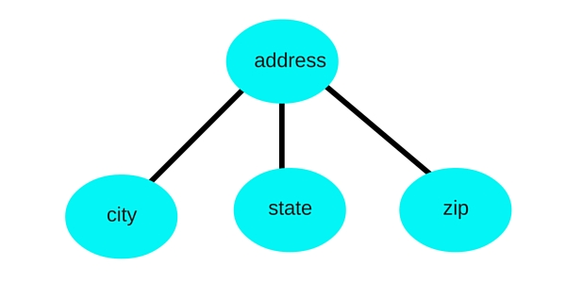
Data, Data Objects and Data Types
Data is of two types
Atomic Data
It consist of single piece of information. It cannot be divided into other meaningful pieces of data. e.g Name of Person, Name of Book
Composite Data
It can be divided into subfields that have meaning.
e.g. Address, Telephone number

Slide 5

Data, Data Objects and Data Types
Data Objects
Data object is referring to set of elements say D.
For Example: Data Object integers refers to D={0,±1,±2,…………………}
Data Object represents an object having a data.
For Example:
If student is one object then it will consist of different data like roll no, name, percentage , address etc.
Roll_ Number
Name
Percentage

Slide 6
Data, Data Objects and Data Types
Data Types
A Data type is a term which refers to the kinds of data that variables may hold in a programming languages.
For Example: In C programming languages, the data types are integer, float, character etc.
Data type is a way to classify various types of data such as integer, string, etc. which determines the values that can be used with the corresponding type of data, the type of operations that can be performed on the corresponding type of data.
There are two data types −
Built-in Data Type
Derived Data Type

Slide 7
Data, Data Objects and Data Types
Built-in Data Type
Those data types for which a language has built-in support are known as Built-in Data types.
For example, most of the languages provide the following built-in data types.
Integers
Boolean (true, false)
Floating (Decimal numbers)
Character and Strings
Derived Data Type
These data types are normally built by the combination of primary or built-in data types and associated operations on them.
For example −
List
Array
Stack
Queue

Slide 8
Abstract Data Type(ADT) and Data Structure
Abstract Data Type
Concern about what can be done not how it can be done
Abstract Data Type consist of
Declaration of Data
Declaration of Operations
Encapsulation of data and operations

Slide 9
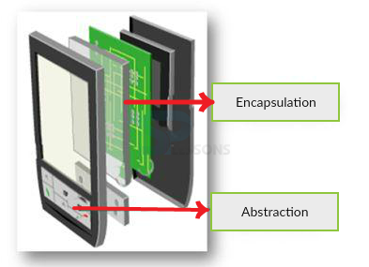
Abstract data types
An abstract data type is a type with associated operations, but whose representation is hidden.
The calculator explains it very well.
One can use it different ways by giving various values and perform operations.
But, mechanism how the operation is done is not shown.
This process of hiding the information is called as Abstraction.

Slide 10
Abstract Data Types (ADT)
An ADT is composed of
A collection of data
A set of operations on that data
Specifications of an ADT indicate
What the ADT operations do, not how to implement them
Implementation of an ADT
Includes choosing a particular data structure

Slide 11
Abstract Data Type(ADT) and Data Structure
structure ARRAY(value, index)
declare CREATE()→array
RETRIVE(array,index)→value
STORE(array,index,value)→array;
for all A ε array, i,j ε index ,x ε value let
RETRIVE (CREATE,i) : : = error
RETRIVE (STORE(A,i,x),j) : : =
if EQUAL(i,j) then x else RETRIVE(A,j)
end
end ARRAY
Abstract Data Type Examples
Array
Tree
Graph
Linked List
Matrix

Slide 12
Data Structure
A data structure is a set of domains D, a structured domain d ε D , a set of functions F and a set of axioms A.
The triple(D,F,A) denotes the data structure d ε D and it will usually be abbreviated by writing d.
The triple(D,F,A) is referred to as an abstract data type (ADT).
It is called abstract precisely because the axioms do not imply a form of representations/implementation.

Slide 13
Data Structure
Example
Structure NATNO
Declare ZERO() → natno
ISZERO(NATNO) → Boolean
SUCC(natno) → natno
ADD(natno,natno) → natno
for all x,y ε natno let
ISZERO(ZERO) :: = true;
ADD(ZERO,y) :: =y;
ISZERO(SUCC(x))= false
D=NATNO
D ε D= {Boolean, natno}
F={ZERO,ISZERO,ADD,SUCC}
AXIOMS

Slide 14
Types of Data Structures
Linear data structure:
The data structure where data items are organized sequentially or linearly where data elements attached one after another is called linear data structure. It has unique predecessor and Successor.
Ex: Arrays, Linked Lists
Non-Linear data structure:
The data structure where data items are not organized sequentially is called non linear data structure. It don’t have unique predecessor or Successor.
In other words, A data elements of the non linear data structure could be connected to more than one elements to reflect a special relationship among them.
Ex: Trees, Graphs

Slide 15

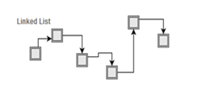
Types of Data Structures
Linear Data Structure
Non Linear Data Structure

Slide 16
Types of Data Structures
Static data structure:
Static Data structure has fixed memory size. It is the memory size allocated to data, which is static.
Ex: Arrays
Dynamic data structure:
In Dynamic Data Structure, the size can be randomly updated during run time which may be considered efficient with respect to memory complexity of the code.
Ex: Linked List
In comparison to dynamic data structures, static data structures provide easier access to elements. Dynamic data structures, as opposed to static data structures, are flexible.

Slide 17
Introduction to Algorithms
Algorithm
Solution to a problem that is independent of any programming language.
Sequence of steps required to solve the problem
Algorithm is a finite set of instructions that if followed, accomplishes a particular task
All algorithms must satisfy the following criteria:
Input: Zero or more Quantities are externally supplied
Output: At least one quantity is produced
Definiteness: Each instruction is clear and unambiguous
Finiteness: if we trace out the instructions of an algorithm then for all cases the algorithm terminates after a finite number of steps.
Effectiveness: Every instruction must be very basic so that it can be carried out in principle by a person using pencil and paper.

Slide 18
Program vs Algorithm
Introduction to Algorithms
A program is a written out set of statements in a language that can be executed by the machine.
An algorithm is simply an idea or a solution to a problem that is often procedurally written.

Slide 19
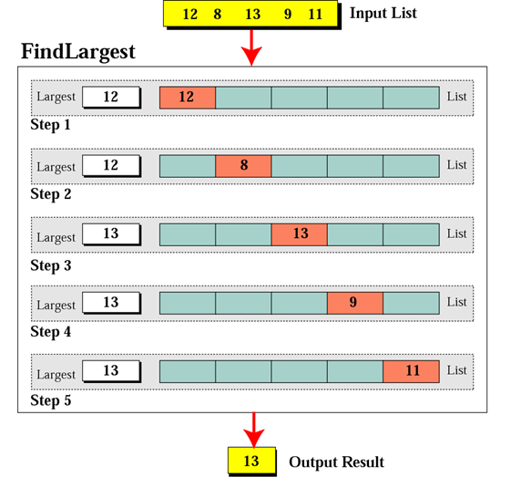
Example : Finding the largest integer among five integers
Introduction to Algorithms

Slide 20
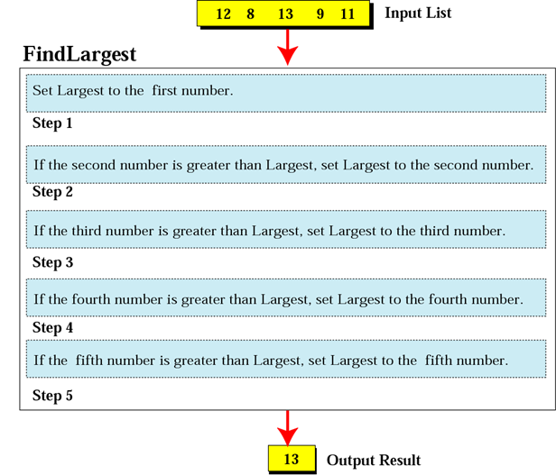
Defining actions in Find Largest algorithm
Introduction to Algorithms

Slide 21
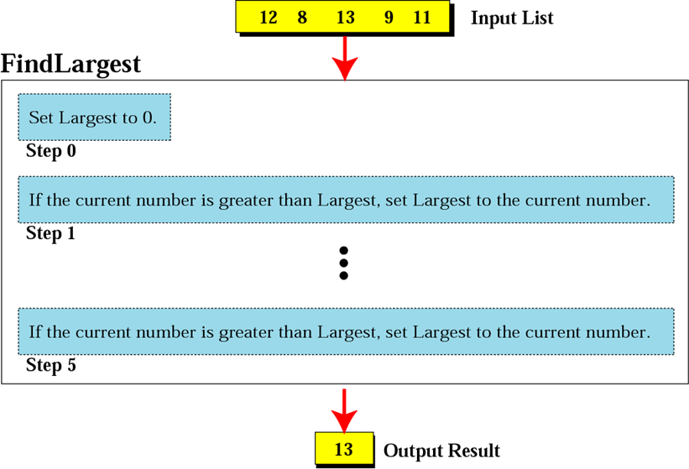
Find Largest refined
Introduction to Algorithms

Slide 22
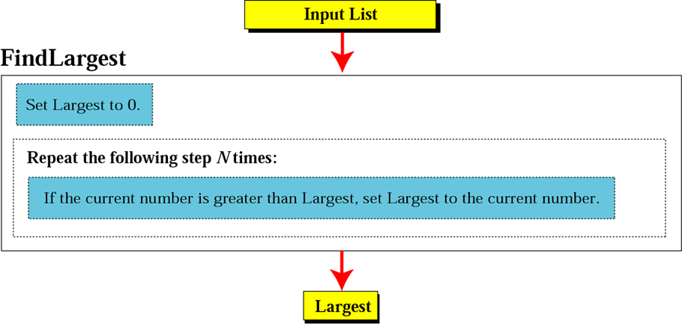
Introduction to Algorithms

Slide 23
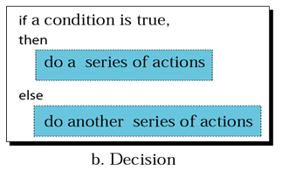
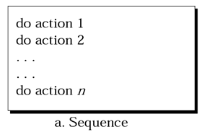
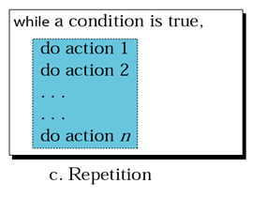
Three constructs
Introduction to Algorithms

Slide 24
Algorithm Design Tools
Pseudo Code
is an artificial and informal language that helps programmers develop algorithms.
Uses English-like phrases with some Visual Basic terms to outline the program
Flowchart
Graphical representation of an algorithm.
Graphically depicts the logical steps to carry out a task and shows how the steps relate to each other.

Slide 25
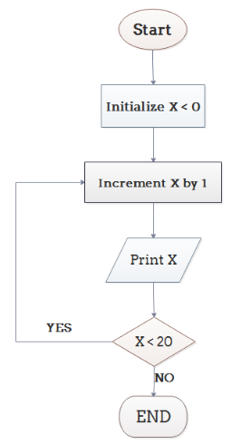
Algorithm Design Tools
Flowchart
Example 1: Print 1 to 20:
Algorithm
Step 1: Initialize X as 0,
Step 2: Increment X by 1,
Step 3: Print X,
Step 4: If X is less than 20 then go back to step 2.

Slide 26
Pseudo Code
Algorithm SORT(A, n)
{
for (i =1;i<n; i++)
{
j = i ;
for (k = j+1;k<n; k++)
{
if A[k] < A[j]
j=k;
}
t = A[i];
A[i]= A[j];
A[j]=t
}
}
Pseudocode is an informal high-level description of the operating principle of a computer program or other algorithm.
It uses the structural conventions of a normal programming language, but is intended for human reading rather than machine reading.

Slide 27
Pseudo Code
Examples
Algorithm grade_assignment( )
{
if (student_grade >= 60) print "passed" else print "failed"
}
Examples
Algorithm grade_count()
{
total=0 grade_counter =1
while (grade_counter<10)
{ read next grade total=total + grade
grade_counter=grade_counter + 1 } class_average=total/10 print class_average.
}

Slide 28
Pseudo Code
Some Keywords That Should be Used And Additional Points:
Algorithm Keyword is used
Curly brackets are used instead of begin-end
Directly programming syntaxes are used
Easy to convert into program
Semicolons used

Slide 29
Pseudo Code
Some Keywords That Should be Used And Additional Points:
Words such as set, reset, increment, compute, calculate, add, sum, multiply, ... print, display, input, output, edit, test , etc. with careful indentation tend to foster desirable pseudocode.
Also, using words such as Set and Initialize, when assigning values to variables is also desirable.

Slide 30
Pseudo Code
Formatting and Conventions in Pseudo code
INDENTATION in pseudocode should be identical to its implementation in a programming language.
Use curly brackets for indentation
No flower boxes (discussed ahead) in your pseudocode.
Do not include data declarations in your pseudocode.
But do cite variables that are initialized as part of their declarations. E.g. "initialize count to zero" is a good entry.

Slide 31
Pseudo Code
Calls to Functions should appear as:
Call FunctionName (arguments: field1, field2, etc.)
Returns in functions should appear as:
Return (field1)
Function headers should appear as:
FunctionName (parameters: field1, field2, etc. )
Functions called with addresses should be written as:
Call FunctionName (arguments: pointer to fieldn, pointer to field1, etc.)
Function headers containing pointers should be indicated as:
FunctionName (parameters: pointer to field1, pointer to field2, ...)
Returns in functions where a pointer is returned:
Return (pointer to fieldn)

Slide 32
Pseudo Code
Function Call
EVERY function should have a flowerbox PRECEDING IT.
This flower box is to include the functions name, the main purpose of the function, parameters it is expecting (number and type), and the type of the data it returns.
All of these listed items are to be on separate lines with spaces in between each explanatory item.
FORMAT of flowerbox should be
********************************************************
Function: ( cryptic text describing single function
....... (indented like this)
.......
Calls: Start listing functions "this" function calls
Show these functions: one per line, indented
Called by: List of functions that calls "this" function
Show these functions: one per line, indented.
Input Parameters: list, if appropriate; else None
Returns: List, if appropriate.
*********************************************************

Slide 33
Pseudo Code
Advantages and Disadvantages
Pseudocode Disadvantages
• It’s not visual
• There is no accepted standard, so it varies widely from company to company
Pseudocode Advantages
• Can be done easily on a word processor
• Easily modified
• Implements structured concepts well

Slide 34
Flow Charts
Flowchart Disadvantages
• Hard to modify
• Need special software
Flowchart Advantages
• Standardized: all pretty much agree on the symbols and their meaning
• Visual

Slide 35
Flow Chart Symbols
Flowchart Symbol
Explanation
Flow lines are indicated by straight lines with optional arrows to show direction of data flow.
An ellipse uses the name of the module at the start. The end is indicated by the word end or stop.
Start/Stop/End
Processing block such as calculations, opening and closing files
Input to or output from the computer
Decision symbol. one entrance and two and only two exits

Slide 36
Drawing the Flowcharts
Flowchart Symbol
Explanation
Process of module. Having one entrance and one exit
Loop within counter. The counter starts with A and incremented by s until the counter is greater than B
A s B
On-page connector. Connects sections on same page
Off Page Connectors

Slide 37
Algorithms and Flowcharts
Algorithm
Flowcharts
Control Module
1.Repeat
Process Read
Process Calc
Process Print
Until
NoMoreEmployee
2.End
Control
Read
Calc
Print
False
Until
noMoreEmployee
True
End

Slide 38
Algorithms and Flowcharts
Algorithm
Flowcharts
Read Module
Read Hours,
Read PayRate
3.Exit
Read
Read
Hours,
PayRate
Exit

Slide 39
Algorithms and Flowcharts
Algorithm
Flowcharts
Calc Module
GrossPay=
HoursWorked
*PayRate
2.Exit
Calc
GrossPay=
HoursWorked*PayRate
Exit

Slide 40
Algorithms and Flowcharts
Algorithm
Flowcharts
Print Module
Print Pay
2.Exit
Print
Print GrossPay
Exit

Slide 41
Algorithms and Flowcharts
Read
Read
Hours,PayRate
Control
Exit
Calc
Read
GrossPay=
Hours*PayRate
Calc
Print
Exit
False
Print
Until
noMoreEmployee
True
Print
GrossPay
End
Exit

Slide 42
Analysis of Algorithms
Finding Efficiency of an algorithm in terms of
Time Complexity
Space Complexity

Slide 43
Analysis of Algorithms
What is time complexity
Finding amount of time required for executing set of instructions or functions
It is represented in terms of frequency count
Frequency count is number of time every instruction of a code is to be executed.
What is space complexity
Finding amount of memory space the program is going to consume.
It is calculated in terms of variables used in program.

Slide 44
Common Rates of Growth
Let n be the size of input to an algorithm, and k some constant. The following are common rates of growth.
Constant: O(k), for example O(1)
Linear: O(n)
Logarithmic: O(log_{k} n)
Linear : n O(n) or n log n: O(n log_{k} n)
Quadratic: O(n² )
Polynomial: O(n^{k} )
Exponential: O(k^{n})

Slide 45
Example
void fun()
{
int a;
a=5;
printf(“%d”,a);
}
void fun()
{
int a;
a=0;
for(i=0;i<n;i++)
{
a=a + i;
}
printf(“%d”,a);
}

Slide 46
Solving Problems
Find Frequency Count and Time Complexity
i=1; do { a++; if(i==5) break; i++; }
while(i<=n);
i=1; do { a++; if(i==5) break; i++; }
while(i<=n);
for(i=1;i<=n;i++)
{
for(j=1;j<=n;j++)
{
C[j][j]=0;
for(k=1;k<=n;k++)
C[i][j]=c[i][j]+a[i][k]*b[k][j];
}
}

Slide 47
i=n; while(i>=1) { i--; }
Find Frequency Count and Time Complexity
i=10; for(i=10;i<=n;i++) for(j=1;j<i;j++) x=x+1;
i=10; for(i=10;i<=n;i++) for(j=1;j<i;j++) x=x+1;

Slide 48
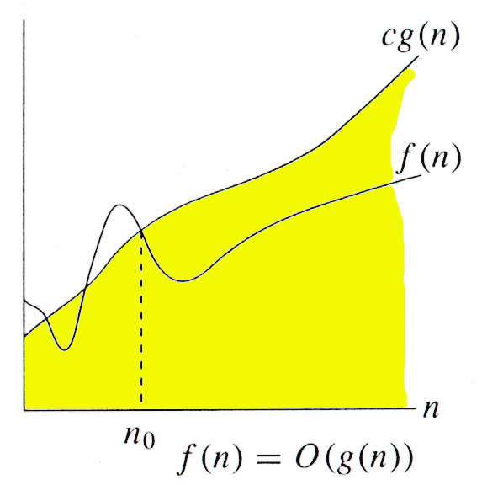
O-notation Example
For a given function g(n), we denote O(g(n)) as the set of
functions:
O(g(n)) = { f(n)| there exists positive constants c and n0 such that 0 ≤ f(n) ≤ c g(n) for all n ≥ n0 }
It is used to represent the worst case growth of an algorithm in time or a data structure in space when they are dependent on n, where n is big enough.

Slide 49
Big Oh - Example
f(n) = n²+ 5n = O(n²)
g(n) = n² ……… c = 2
n n²+ 5n 2n²
1 5 2
2 14 8
5 50 50
f(n) <= c g(n) for all n> = n₀ where c=2 & n₀ =5

Slide 50
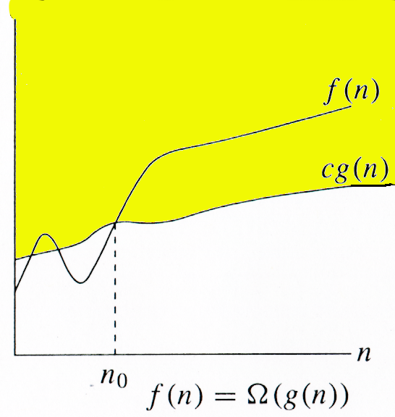
Ω -notation
Ω (g(n)) represents a set of functions such that:
Ω(g(n)) = {f(n): there exist positive constants c and n0 such that 0 ≤ c g(n) ≤ f(n) for all n≥ n0}

Slide 51
Big Omega - Example
Example 1 :
f(n) = n²+ 5n
g(n) = n² ……… c = 1
n n²+ 5n c*n²
¹ ⁵ ¹
2 14 4
5 50 25
f(n) >= c g(n) for all n> = n₀ where c=1 & n₀ =1
Example 1 :
Prove that if T(n) = 15n³ + n² + 4, T(n) = Ω (n³).
Proof.
Let c = 15 and n₀ = 1.
Must show that 0 ≤ cg(n) and cg(n) ≤ f (n).
0 ≤ 15n³ for all n ≥ n₀ = 1.
cg(n) = 15n³ ≤ 15n³ + n² + 4 = f (n)

Slide 52
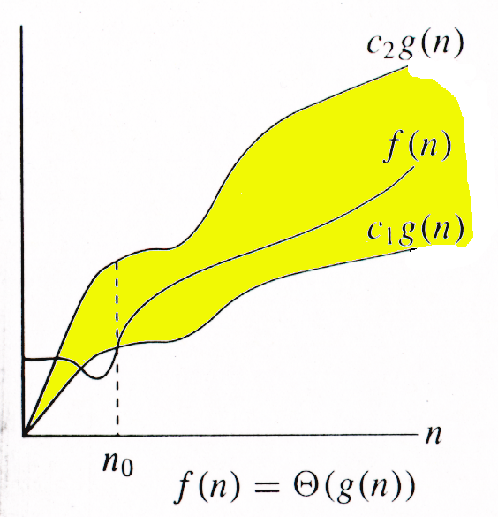
Θ-notation
Asymptotic tight bound
Θ (g(n)) represents a set of functions such that:
Θ (g(n)) = {f(n): there exist positive
constants c1, c2, and n0such
that 0 ≤ c1g(n) ≤ f(n) ≤ c2g(n)
for all n≥ n0 }

Slide 53
Theta Example
f(N) = Θ(g(N)) iff f(N) = O(g(N)) and f(N) = Ω(g(N))
It can be read as “f(N) has order exactly g(N)”.
The growth rate of f(N) equals the growth rate of g(N). The
growth rate of f(N) is the same as the growth rate of g(N)
for large N.
Theta means the bound is the tightest possible.
If T(N) is a polynomial of degree k, T(N) = Θ(N^{k}).
For logarithmic functions, T(log_{m} N) = Θ(log N).

Slide 54
Analysis of Algorithms
Algorithm analysis is done in following three cases
Best Case
The amount of time a program might be expected to take on best possible input data
Worst Case
The amount of time a program would take on worst possible input configuration.
Average case
The amount of time a program might be expected to take on typical(or average) input data
Example: Sorting Algorithms

Slide 55
Practice Assignments
Write a pseudo code and draw flowchart to input any alphabet and check whether it is vowel or consonant.
Write a pseudo code to check whether a number is even or odd
Write a pseudo code to check whether a year is leap year or not.
Write a pseudo code to check whether a number is negative, positive or zero
Write a pseudo code to input basic salary of an employee and calculate its Gross salary according to following: Basic Salary <= 10000 : HRA = 20%, DA = 80% Basic Salary <= 20000 : HRA = 25%, DA = 90% Basic Salary > 20000 : HRA = 30%, DA = 95%

Slide 56
Practice Problems
Q.1 Determine frequency count of following statements? Analyze time complexity of the following code:
i) for (i=1;i<=n;i++)
for (j=1;j<=m;j++)
sum=sum+i;
ii) i=n;
while(i>=1)
{
i--;
}

Slide 57
Practice Problems
Problems on frequency count & time complexity
for(i=1;i<=n;i++)
{
For(j=1;j<=n;j++)
{
C[j][j]=0;
For(k=1;k<=n;k++)
C[i][j]=c[i][j]+a[i][k]*b[k][j];
}
}
double IterPow(double X,int N) { double Result=1; while(N>0) { Result=Result* X N--; } return result;

Slide 58
Practice Problems
Q.3 What is the frequency count of a statement? Analyze time complexity of following code?
for(i=1;i<=n;i++)
for(j=1;j<=m;j++)
for(k=1;k<=p;k++)
{
Sum=sum+i
}

Slide 59
Takeaway
Data Structures plays major role in problem solving.
Pseudo code and flowcharts are the tools used to represent the solution of a problem in effective way.
Analysis of algorithms is done in terms of time complexity and space complexity.

